Slide 1
Self-efficacy, Motivation and Productivity-Boosting Strategies for Smart Workers
Partner: Kleinon
Legal description – Creative Commons licensing: The materials published on the SWIFTSME project website are classified as Open Educational Resources' (OER) and can be freely (without permission of their creators): downloaded, used, reused, copied, adapted, and shared by users, with information about the source of their origin.
The European Commission's support for the production of this publication does not constitute an endorsement of the contents, which reflect the views only of the authors, and the Commission cannot be held responsible for any use which may be made of the information contained therein.

Slide 2
Objectives & Goals
Acknowledge the importance of self-reliance in smart working
Motivate yourself, improve your autonomy
How smart work is different from traditional environments in terms of autonomy and motivation sources
Understanding self-motivation and its importance in relation to smart-working
At the end of this module you will be able to:
Understand how self efficacy works
Improve your productivity
What it is, how it influences your working performance, why is it important for smart workers
Playing your way to success, staying focused, avoiding distractions and time wasters
Legal description – Creative Commons licensing: The materials published on the SWIFTSME project website are classified as Open Educational Resources' (OER) and can be freely (without permission of their creators): downloaded, used, reused, copied, adapted, and shared by users, with information about the source of their origin.
The European Commission's support for the production of this publication does not constitute an endorsement of the contents, which reflect the views only of the authors, and the Commission cannot be held responsible for any use which may be made of the information contained therein.

Slide 3
Index
Introduction
Self-efficacy
Self-motivation
Productivity-boosting Strategies
Smart Work and Its Challenges
Self-efficacy, Motivation and Focus in EU Competence Frameworks
What Is Self-Efficacy
How Self-Efficacy Works
What is Self-motivation
and
Why is
it Important in Smart Working Contexts
Productivity Strategies and Games
Focus
Avoiding
Distractions
Intro
Unit 2
Unit 3
Unit 1
Legal description – Creative Commons licensing: The materials published on the SWIFTSME project website are classified as Open Educational Resources' (OER) and can be freely (without permission of their creators): downloaded, used, reused, copied, adapted, and shared by users, with information about the source of their origin.
The European Commission's support for the production of this publication does not constitute an endorsement of the contents, which reflect the views only of the authors, and the Commission cannot be held responsible for any use which may be made of the information contained therein.

Slide 4
Intro
Introduction. Why ‘self’?
The COVID19 pandemic has not only shown us the indisputable importance of smart working and teleworking in preserving jobs and keeping economies alive, but also made it clear that each of us needs to (quickly) learn to rely on ourselves more than on external factors.
This module brings to attention several important points: self-efficacy, self-motivation, focus, productivity – and how can we improve our skills and learn to walk or play our way through our work which can sometimes be challenging, boring or strenuous – by ourselves, without the external motivation factors and immediate pressure of a traditional workplace.
Legal description – Creative Commons licensing: The materials published on the SWIFTSME project website are classified as Open Educational Resources' (OER) and can be freely (without permission of their creators): downloaded, used, reused, copied, adapted, and shared by users, with information about the source of their origin.
The European Commission's support for the production of this publication does not constitute an endorsement of the contents, which reflect the views only of the authors, and the Commission cannot be held responsible for any use which may be made of the information contained therein.

Slide 5
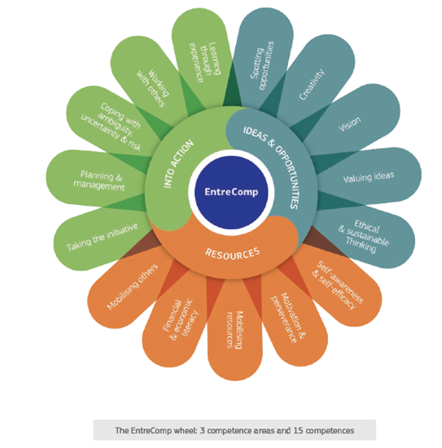
Intro
Introduction. Self-efficacy & Motivation in EU Frameworks
The importance of self-efficacy and ability to stay motivated even in adverse contexts, focus, set and reach goals is widely recognized and especially important in highly entrepreneurial environments.
The European Framework EntreComp lists self-efficacy and motivation among the 15 core competences of entrepreneurship.
This module brings to attention several important points: self-efficacy, self-motivation, focus, productivity – and how can we improve ourselves and learn to walk or play our way through our work which can sometimes be challenging, boring or strenuous – by ourselves, without the external motivation factors and immediate pressure of a traditional workplace.
Legal description – Creative Commons licensing: The materials published on the SWIFTSME project website are classified as Open Educational Resources' (OER) and can be freely (without permission of their creators): downloaded, used, reused, copied, adapted, and shared by users, with information about the source of their origin.
The European Commission's support for the production of this publication does not constitute an endorsement of the contents, which reflect the views only of the authors, and the Commission cannot be held responsible for any use which may be made of the information contained therein.

Slide 6
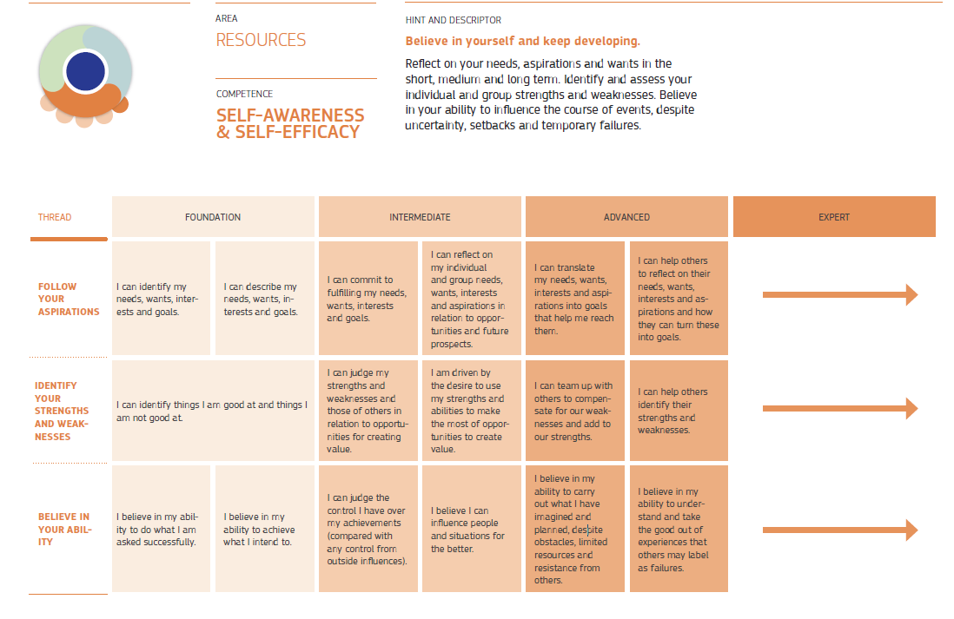
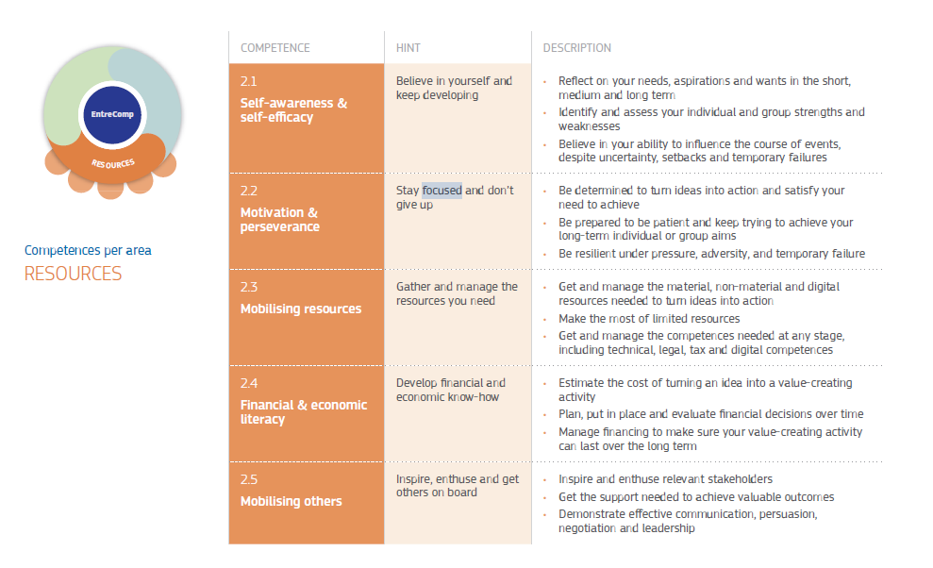
Intro
Introduction. Self-efficacy & motivation in EU Frameworks
Tip: There are dedicated modules within SWIFT training to help you better understand EU frameworks.
Self-efficacy listed in EntreComp under resources area, thread ‘believe in your ability’, different proficiency levels
Legal description – Creative Commons licensing: The materials published on the SWIFTSME project website are classified as Open Educational Resources' (OER) and can be freely (without permission of their creators): downloaded, used, reused, copied, adapted, and shared by users, with information about the source of their origin.
The European Commission's support for the production of this publication does not constitute an endorsement of the contents, which reflect the views only of the authors, and the Commission cannot be held responsible for any use which may be made of the information contained therein.

Slide 7
Unit 1
WEAKNESS
You can simply impress your audience and add a unique zing
You can simply impress you audience and add a unique zing
Section 1. What is self-efficacy?
Definition
S
W
The power of believing in your own ability to succeed
Context
You can simply impress your audience ad add a unique zing
How is self-efficacy relevant for smart workers
You can simply impress your audience and add a unique zing
Legal description – Creative Commons licensing: The materials published on the SWIFTSME project website are classified as Open Educational Resources' (OER) and can be freely (without permission of their creators): downloaded, used, reused, copied, adapted, and shared by users, with information about the source of their origin.
The European Commission's support for the production of this publication does not constitute an endorsement of the contents, which reflect the views only of the authors, and the Commission cannot be held responsible for any use which may be made of the information contained therein.

Slide 8
Unit 1
Section 1. What is self-efficacy?
The concept of self-efficacy is not new – being first proposed in 1977 by Stanford professor and psychologist Albert Bandura. He defines self-efficacy in his works as ‘’a person’s particular set of beliefs that determine how well one can execute a plan of action in prospective situations.’’
Further research show that self-efficacy might be especially relevant in the context of smart working, which requires a greater level of job autonomy and increased creative behavior, stress resilience, and self-discipline.
Legal description – Creative Commons licensing: The materials published on the SWIFTSME project website are classified as Open Educational Resources' (OER) and can be freely (without permission of their creators): downloaded, used, reused, copied, adapted, and shared by users, with information about the source of their origin.
The European Commission's support for the production of this publication does not constitute an endorsement of the contents, which reflect the views only of the authors, and the Commission cannot be held responsible for any use which may be made of the information contained therein.

Slide 9
Unit 1
Section 1. What is self-efficacy?
Now more than ever, with all the changes of the new working paradigm, people need to be able to cope with uncertainty, stress, set their own goals, motivate themselves, make decisions on their own, learn and adapt on the go.
With a high level of self-efficacy, the chances of goal accomplishment increase, as well as the difficulty of challenges you set for yourself. Instead of getting scared of difficult tasks, lack of directions, indications and immediate feedback, you learn to see those things as something you want to master rather than something you want to avoid.
Legal description – Creative Commons licensing: The materials published on the SWIFTSME project website are classified as Open Educational Resources' (OER) and can be freely (without permission of their creators): downloaded, used, reused, copied, adapted, and shared by users, with information about the source of their origin.
The European Commission's support for the production of this publication does not constitute an endorsement of the contents, which reflect the views only of the authors, and the Commission cannot be held responsible for any use which may be made of the information contained therein.

Slide 10
Unit 1
Performance Outcomes
Positive and negative experiences influence further performance at given tasks.
Previous positive performance at a given task increases peoples’ trust in their own ability of performing well at a similar task in the future.
WEAKNESS
You can simply impress your audience and add a unique zing
Vicarious Experiences
Vicarious Experiences
You can simply impress you audience and add a unique zing
Seeing similar people performing well at a given task increases individuals’ belief that they can also do well in similar conditions.
Section 2. How Self-efficacy Works?
S
W
Verbal Persuasion
Positive verbal reinforcement encourages people to believe they have the necessary skills to perform well.
Physiological Feedback
Boosting self-efficacy is easier when one fells psychologically and physically well.
Imagined Experiences
Making success seem like the most outcome by visualizing oneself as behaving effectively while performing the task can increase the chances of success.
Legal description – Creative Commons licensing: The materials published on the SWIFTSME project website are classified as Open Educational Resources' (OER) and can be freely (without permission of their creators): downloaded, used, reused, copied, adapted, and shared by users, with information about the source of their origin.
The European Commission's support for the production of this publication does not constitute an endorsement of the contents, which reflect the views only of the authors, and the Commission cannot be held responsible for any use which may be made of the information contained therein.

Slide 11
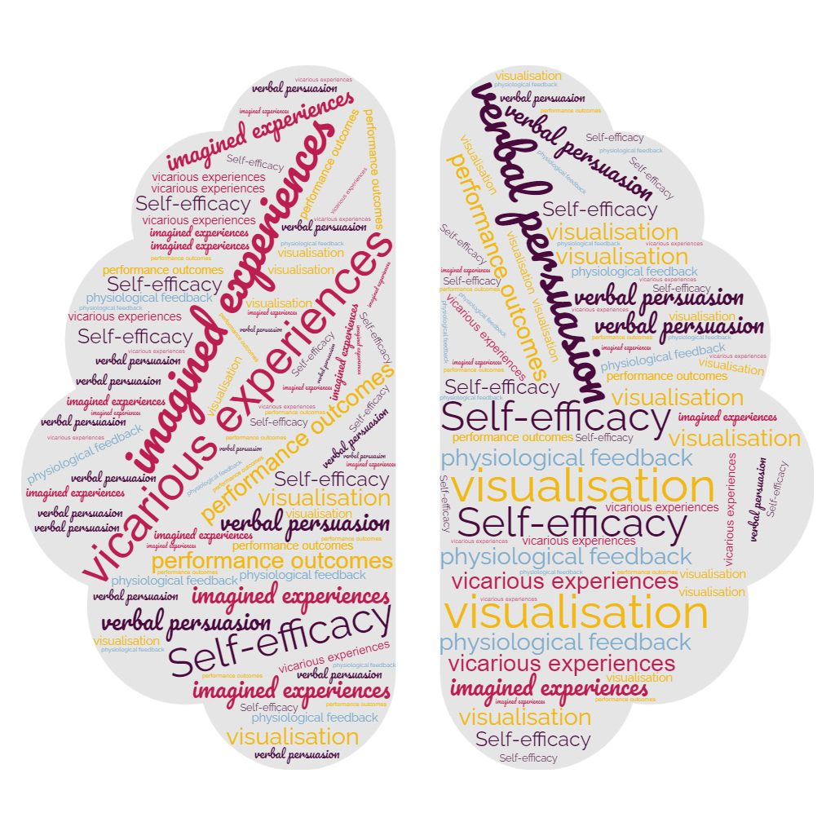
Unit 1
Section 2. How Self-efficacy Works?
Albert Bandura signaled 4 sources from which individuals interpret information in order to build their self-efficacy: performance outcomes, vicarious experiences, verbal persuasion and physiological feedback.
An additional not to neglect source – imagined experiences or visualization is stated later by James Maddux.
Legal description – Creative Commons licensing: The materials published on the SWIFTSME project website are classified as Open Educational Resources' (OER) and can be freely (without permission of their creators): downloaded, used, reused, copied, adapted, and shared by users, with information about the source of their origin.
The European Commission's support for the production of this publication does not constitute an endorsement of the contents, which reflect the views only of the authors, and the Commission cannot be held responsible for any use which may be made of the information contained therein.

Slide 12
Unit 1
Section 2. How Self-efficacy Works?
Performance Outcomes
It’s easier to believe that you will succeed at a task when you have previously had positive results with similar ones.
Making a list of situations you did well at your work or when you took on new challenges will help you improve your confidence. Although you might not encounter exactly the same situation – look closer for similarities.
Legal description – Creative Commons licensing: The materials published on the SWIFTSME project website are classified as Open Educational Resources' (OER) and can be freely (without permission of their creators): downloaded, used, reused, copied, adapted, and shared by users, with information about the source of their origin.
The European Commission's support for the production of this publication does not constitute an endorsement of the contents, which reflect the views only of the authors, and the Commission cannot be held responsible for any use which may be made of the information contained therein.

Slide 13
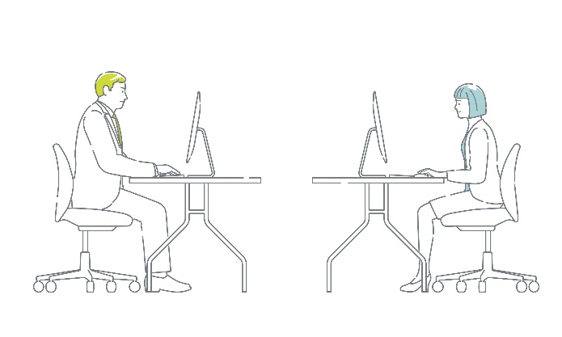
Unit 1
Section 2. How Self-efficacy Works?
Vicarious experiences
It’s also easier to believe you can accomplish something when you see someone similar to you doing it.
When taking on a challenge that is new for you - keep an eye on your colleagues, friends, or people with similar positions/skills from other companies. If they did it, chances are you can do it too.
! Stay objective: we often tend to overestimate other peoples’ qualities just because they were bold enough to ‘just do it’, or vice-versa – to over-estimate our own level of competence, usually when we aren’t competent enough to realize we’re wrong.
Legal description – Creative Commons licensing: The materials published on the SWIFTSME project website are classified as Open Educational Resources' (OER) and can be freely (without permission of their creators): downloaded, used, reused, copied, adapted, and shared by users, with information about the source of their origin.
The European Commission's support for the production of this publication does not constitute an endorsement of the contents, which reflect the views only of the authors, and the Commission cannot be held responsible for any use which may be made of the information contained therein.

Slide 14
Unit 1
Section 2. How Self-efficacy Works?
Verbal Persuasion
Having other people encouraging and convincing us that we have the necessary qualities to complete tasks is also empowering and a source of self-efficacy.
Although the simple fact that you’ve been assigned a task usually implies that those who chose you to do it believe in your capacity of successfully completing it, you can also ask for feedback from colleagues or other significant people such as mentors or superiors. Listen only to those who really have the necessary skills themselves to give you an advised opinion. Stay away from negative people or those who might have reasons to discourage you. Provide encouragement to others yourself whenever possible and reasonable.
Legal description – Creative Commons licensing: The materials published on the SWIFTSME project website are classified as Open Educational Resources' (OER) and can be freely (without permission of their creators): downloaded, used, reused, copied, adapted, and shared by users, with information about the source of their origin.
The European Commission's support for the production of this publication does not constitute an endorsement of the contents, which reflect the views only of the authors, and the Commission cannot be held responsible for any use which may be made of the information contained therein.

Slide 15
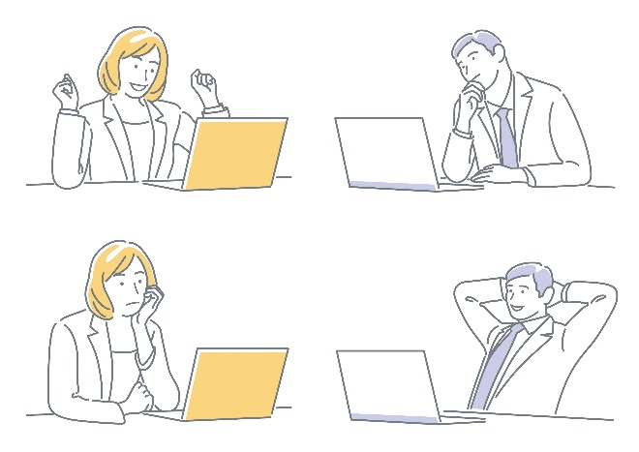
Unit 1
Section 2. How Self-efficacy Works?
Physiological Feedback
Emotional and physiological states can influence the way we perceive our capacity of performing well. Depression or illness for example might make us judge negatively our self-efficacy, while positive states (feeling happy/energetic) will make us feel as we can do anything.
Learn to take those elements into consideration when judging your own capacity of completing tasks and try to remain as objective as possible. Remember that nothing lasts forever. You will sooner or later get out of any situation or state. If indeed a negative state limits your abilities to complete your plans, remember is only temporary and not definitory for your real level of competence.
Legal description – Creative Commons licensing: The materials published on the SWIFTSME project website are classified as Open Educational Resources' (OER) and can be freely (without permission of their creators): downloaded, used, reused, copied, adapted, and shared by users, with information about the source of their origin.
The European Commission's support for the production of this publication does not constitute an endorsement of the contents, which reflect the views only of the authors, and the Commission cannot be held responsible for any use which may be made of the information contained therein.

Slide 16
Unit 1
Section 2. How Self-efficacy Works?
Imagined experiences
Also known as visualization – involves imagining yourself performing and successfully completing a given task, and it is the fifth route to increased self-efficacy. It is either intentionally or unintentionally – broadly used by high achievers, including performance athletes.
Of course, you will still have to put in the effort – but you will be mentally prepared to take whatever it comes.
Legal description – Creative Commons licensing: The materials published on the SWIFTSME project website are classified as Open Educational Resources' (OER) and can be freely (without permission of their creators): downloaded, used, reused, copied, adapted, and shared by users, with information about the source of their origin.
The European Commission's support for the production of this publication does not constitute an endorsement of the contents, which reflect the views only of the authors, and the Commission cannot be held responsible for any use which may be made of the information contained therein.

Slide 17
Unit 2
WEAKNESS
You can simply impress your audience and add a unique zing
You can simply impress you audience and add a unique zing
Section 1. What is Self-motivation and Why Is It Important for Smart Workers
Definition
S
W
Why we do what we do
Context
You can simply impress your audience ad add a unique zing
How is self-motivation relevant for smart workers
You can simply impress your audience and add a unique zing
Legal description – Creative Commons licensing: The materials published on the SWIFTSME project website are classified as Open Educational Resources' (OER) and can be freely (without permission of their creators): downloaded, used, reused, copied, adapted, and shared by users, with information about the source of their origin.
The European Commission's support for the production of this publication does not constitute an endorsement of the contents, which reflect the views only of the authors, and the Commission cannot be held responsible for any use which may be made of the information contained therein.

Slide 18
Unit 2
Section 1. What is self-motivation and why is it important for smart workers
Definition
‘Self-motivation is the internal state that helps us initiate, continue, or terminate a behavior.’ (Berkley Well-Being Institute)
Examples of self-motivation:
Starting and completing tasks in time without the need of external supervision or pressure
Remaining focused on what we have to do long enough to achieve our goals
Initiating new projects or actions even if we are not obliged in any way to do so
Legal description – Creative Commons licensing: The materials published on the SWIFTSME project website are classified as Open Educational Resources' (OER) and can be freely (without permission of their creators): downloaded, used, reused, copied, adapted, and shared by users, with information about the source of their origin.
The European Commission's support for the production of this publication does not constitute an endorsement of the contents, which reflect the views only of the authors, and the Commission cannot be held responsible for any use which may be made of the information contained therein.

Slide 19
Unit 2
Section 1. What is self-motivation and why is it important for smart workers
Why is self-motivation so important for smart workers?
Smart work is defined by high degrees of flexibility and autonomy.
While in a classical working environment we tend to adapt our working style and rhythm to that of the colleagues, or to the immediate requirements from superiors, as smart workers we are free to organize our work and priorities, the working environment is more fluid and the degree of external control is much reduced.
Sounds great – but not that easy - we often have to wait longer for feedback and there’s no one there to break difficult tasks into bite-sized chunks for us.
Legal description – Creative Commons licensing: The materials published on the SWIFTSME project website are classified as Open Educational Resources' (OER) and can be freely (without permission of their creators): downloaded, used, reused, copied, adapted, and shared by users, with information about the source of their origin.
The European Commission's support for the production of this publication does not constitute an endorsement of the contents, which reflect the views only of the authors, and the Commission cannot be held responsible for any use which may be made of the information contained therein.

Slide 20
Unit 2
Section 1. What is self-motivation and why is it important for smart workers
When you have choices (e.g. choosing what you want to work on, when, where and for how long) it is more difficult to keep a pace that ensures the expected results.
Moreover, you are exposed to various distractors or temptations (e.g. social media, ‘busy work’, daydreaming, chores around the house), and more prone to avoidant behaviors (procrastination, doing work which is not meaningful/necessary – or not relevant for the moment just to avoid doing what you actually have to do).
Although you might feel as you’re working longer hours – in reality you find yourself actually getting less done or consistently missing deadlines.
Legal description – Creative Commons licensing: The materials published on the SWIFTSME project website are classified as Open Educational Resources' (OER) and can be freely (without permission of their creators): downloaded, used, reused, copied, adapted, and shared by users, with information about the source of their origin.
The European Commission's support for the production of this publication does not constitute an endorsement of the contents, which reflect the views only of the authors, and the Commission cannot be held responsible for any use which may be made of the information contained therein.

Slide 21
Unit 2
Section 1. What is self-motivation and why is it important for smart workers
Finding your inner ‘why’ helps you to remain focused, do what you have to and also save time to do what is really meaningful to you.
Self motivation benefits:
- Improved ability to focus without unnecessarily spending energy (as when you do when you have to ‘force’ yourself to do things); You may actually start enjoying your work for itself;
Reduced stress levels;
Improved performance and productivity;
An overall sense of well-being and accomplishment;
Legal description – Creative Commons licensing: The materials published on the SWIFTSME project website are classified as Open Educational Resources' (OER) and can be freely (without permission of their creators): downloaded, used, reused, copied, adapted, and shared by users, with information about the source of their origin.
The European Commission's support for the production of this publication does not constitute an endorsement of the contents, which reflect the views only of the authors, and the Commission cannot be held responsible for any use which may be made of the information contained therein.

Slide 22
Unit 2
Section 1. What is self-motivation and why is it important for smart workers
What improves self-motivation:
Setting smart goals (from daily goals to broader, life goals)
Understanding you are in control
Improving your level of competence (setting time for learning new skills or improving the existing ones constantly)
Gratitude (how many other people would like to be in your place and do the work you have to do?)
Legal description – Creative Commons licensing: The materials published on the SWIFTSME project website are classified as Open Educational Resources' (OER) and can be freely (without permission of their creators): downloaded, used, reused, copied, adapted, and shared by users, with information about the source of their origin.
The European Commission's support for the production of this publication does not constitute an endorsement of the contents, which reflect the views only of the authors, and the Commission cannot be held responsible for any use which may be made of the information contained therein.

Slide 23
Unit 3
WEAKNESS
You can simply impress your audience and add a unique zing
You can simply impress you audience and add a unique zing
Section 1. Productivity Strategies
Productivity
S
W
What and why
Tips to increase your productivity and effectiveness
Goal setting, productivity games, what to do when work is boring, productivity tools
Legal description – Creative Commons licensing: The materials published on the SWIFTSME project website are classified as Open Educational Resources' (OER) and can be freely (without permission of their creators): downloaded, used, reused, copied, adapted, and shared by users, with information about the source of their origin.
The European Commission's support for the production of this publication does not constitute an endorsement of the contents, which reflect the views only of the authors, and the Commission cannot be held responsible for any use which may be made of the information contained therein.

Slide 24
Unit 3
Section 1. Productivity Strategies
More and more studies come to confirm the fact that smart work and remote work boost productivity.
Apart from the reticence and resistance to change, many people seem to enjoy smart working, especially in a hybrid formula.
However, until new habits are formed, and companies learn how to better support and coach their employees, there might be some challenges you want to address while working autonomously: as underlined in the previous sections, you have to rely more on yourself to do the right things in the right time even if you don’t feel like doing so or you are more exposed to distractions.
Legal description – Creative Commons licensing: The materials published on the SWIFTSME project website are classified as Open Educational Resources' (OER) and can be freely (without permission of their creators): downloaded, used, reused, copied, adapted, and shared by users, with information about the source of their origin.
The European Commission's support for the production of this publication does not constitute an endorsement of the contents, which reflect the views only of the authors, and the Commission cannot be held responsible for any use which may be made of the information contained therein.

Slide 25
Unit 3
Section 1. Productivity Strategies
There is no universal success recipe to fit the particularities of each and every smart worker. Dress up, put on make-up – or don’t if this helps you get more (and better) done.
As a smart worker, chances are you already operate in a knowledge-rich environment, and you are familiar with researching your own way.
However, there are some ideas you might want to take into consideration and adapt to your specific needs.
Legal description – Creative Commons licensing: The materials published on the SWIFTSME project website are classified as Open Educational Resources' (OER) and can be freely (without permission of their creators): downloaded, used, reused, copied, adapted, and shared by users, with information about the source of their origin.
The European Commission's support for the production of this publication does not constitute an endorsement of the contents, which reflect the views only of the authors, and the Commission cannot be held responsible for any use which may be made of the information contained therein.

Slide 26
Unit 3
Section 1. Productivity Strategies
Goal setting
It helps to know exactly what you want to accomplish and in which time frame. Some people are better motivated when they set daily goals. Others might be more comfortable working with broader goals (e.g. project goals).
Legal description – Creative Commons licensing: The materials published on the SWIFTSME project website are classified as Open Educational Resources' (OER) and can be freely (without permission of their creators): downloaded, used, reused, copied, adapted, and shared by users, with information about the source of their origin.
The European Commission's support for the production of this publication does not constitute an endorsement of the contents, which reflect the views only of the authors, and the Commission cannot be held responsible for any use which may be made of the information contained therein.

Slide 27
Unit 3
Section 1. Productivity Strategies
What to take into consideration when you set work goals
The overall team goals (if you’re part of a team)
Your broader life goals
Your natural working rhythm (do you prefer working steadily, at an equal pace or do you tend to work in bursts of energy);
When does your energy levels peak through the day
Planning time for rest, disconnecting, learning
Quiet time for goal setting☺ and review
Don’t forget about the 80/20 rule (also know as Pareto Principle – states that 80 % of results come out of 20% of our actions).
Legal description – Creative Commons licensing: The materials published on the SWIFTSME project website are classified as Open Educational Resources' (OER) and can be freely (without permission of their creators): downloaded, used, reused, copied, adapted, and shared by users, with information about the source of their origin.
The European Commission's support for the production of this publication does not constitute an endorsement of the contents, which reflect the views only of the authors, and the Commission cannot be held responsible for any use which may be made of the information contained therein.

Slide 28
Unit 3
Section 1. Productivity Strategies
Productivity Games
Sometimes we are motivated to perform tasks or take on projects for the sake of the challenge. Because we know what we are to do matters, or it’s difficult and complex and it’s up to us to do it – no one else can do it better.
However, there are times when our work might be boring or monotonous, or below our skill level – but we still have to do it. In a regular work setting it might be easier to do this due to external pressure. But as a smart worker you will have to find ways to motivate yourself.
Legal description – Creative Commons licensing: The materials published on the SWIFTSME project website are classified as Open Educational Resources' (OER) and can be freely (without permission of their creators): downloaded, used, reused, copied, adapted, and shared by users, with information about the source of their origin.
The European Commission's support for the production of this publication does not constitute an endorsement of the contents, which reflect the views only of the authors, and the Commission cannot be held responsible for any use which may be made of the information contained therein.

Slide 29
Unit 3
Section 1. Productivity Strategies
Productivity Games
If your work is not challenging enough at times, make it so – it will feel more enjoyable.
Examples of such challenges:
How much of X work can I accomplish in 30 minutes/1h/day?
How fast can I complete X?
Can I find an easier way to do X (e.g. automatize)?
Is there any way X can be done better in the same amount of time?
Legal description – Creative Commons licensing: The materials published on the SWIFTSME project website are classified as Open Educational Resources' (OER) and can be freely (without permission of their creators): downloaded, used, reused, copied, adapted, and shared by users, with information about the source of their origin.
The European Commission's support for the production of this publication does not constitute an endorsement of the contents, which reflect the views only of the authors, and the Commission cannot be held responsible for any use which may be made of the information contained therein.

Slide 30
Unit 3
WEAKNESS
You can simply impress your audience and add a unique zing
You can simply impress you audience and add a unique zing
Section 2. Avoiding distractions and remaining focused
Focus
S
W
What it is and why is it so difficult to maintain it
Distractions
What are the main sources of external and internal distractions
Legal description – Creative Commons licensing: The materials published on the SWIFTSME project website are classified as Open Educational Resources' (OER) and can be freely (without permission of their creators): downloaded, used, reused, copied, adapted, and shared by users, with information about the source of their origin.
The European Commission's support for the production of this publication does not constitute an endorsement of the contents, which reflect the views only of the authors, and the Commission cannot be held responsible for any use which may be made of the information contained therein.

Slide 31
Unit 3
Section 2. Avoiding distractions and remaining focused
Focus
‘the ability of an individual to direct mental effort on the most relevant information in the environment’. (Center for Performance Psychology)
Focus is a skill and it can be improved with appropriate practice and perseverance. Whereas some people might find it easier to focus than others in various situation this doesn’t mean there’s nothing that can be done about it.
The ability to focus depends on multiple variables (mental, physical, environmental) and fluctuates in time.
Legal description – Creative Commons licensing: The materials published on the SWIFTSME project website are classified as Open Educational Resources' (OER) and can be freely (without permission of their creators): downloaded, used, reused, copied, adapted, and shared by users, with information about the source of their origin.
The European Commission's support for the production of this publication does not constitute an endorsement of the contents, which reflect the views only of the authors, and the Commission cannot be held responsible for any use which may be made of the information contained therein.

Slide 32
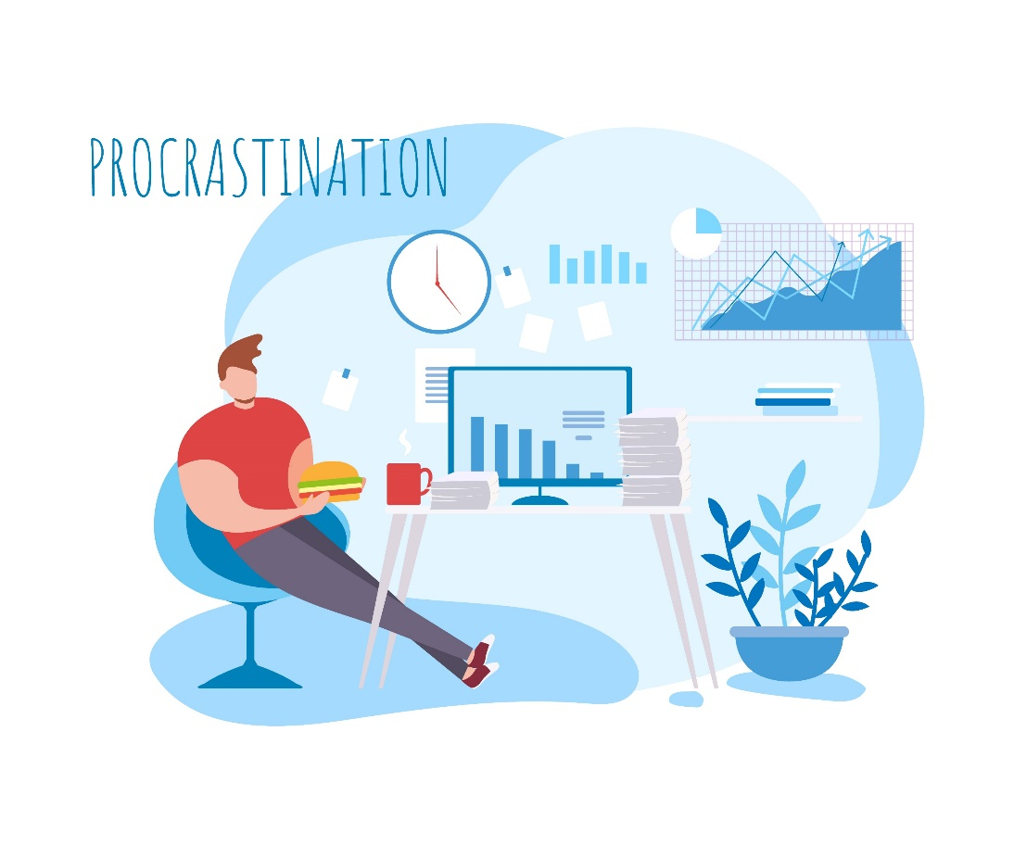
Unit 3
Section 2. Avoiding distractions and remaining focused
Distractions
External:
Social media
Multi tasking
Answering emails (unless your main job is answering emails)
Chatting with colleagues
Chores around the house
Internal: over or under-stimulation, negative self-talk, unresolved issues, worry, fatigue
Legal description – Creative Commons licensing: The materials published on the SWIFTSME project website are classified as Open Educational Resources' (OER) and can be freely (without permission of their creators): downloaded, used, reused, copied, adapted, and shared by users, with information about the source of their origin.
The European Commission's support for the production of this publication does not constitute an endorsement of the contents, which reflect the views only of the authors, and the Commission cannot be held responsible for any use which may be made of the information contained therein.

Slide 33
Summing up
Self-efficacy
Self-motivation
Insert contents
Insert contents
Productivity
Avoiding distractions & staying focused
Goal setting & Productivity strategies
Understanding focus and the main sources of distraction
Setting smart goals, employing productivity strategies, making use of productivity games
Legal description – Creative Commons licensing: The materials published on the SWIFTSME project website are classified as Open Educational Resources' (OER) and can be freely (without permission of their creators): downloaded, used, reused, copied, adapted, and shared by users, with information about the source of their origin.
The European Commission's support for the production of this publication does not constitute an endorsement of the contents, which reflect the views only of the authors, and the Commission cannot be held responsible for any use which may be made of the information contained therein.

Slide 34
THANK YOU
Legal description – Creative Commons licensing: The materials published on the SWIFTSME project website are classified as Open Educational Resources' (OER) and can be freely (without permission of their creators): downloaded, used, reused, copied, adapted, and shared by users, with information about the source of their origin.
The European Commission's support for the production of this publication does not constitute an endorsement of the contents, which reflect the views only of the authors, and the Commission cannot be held responsible for any use which may be made of the information contained therein.

